Slide 1
11-dars(Model Building)
Davronbek Malikov

Slide 2

Bugun
Takrorlash
Support Vector Machine ---Nazariy
SVC
SCR
Support Vector Machine – Amaliy
Vazifa

Slide 3
Takrorlash

Slide 4
Takrorlash
Takrorlash
Random Forest
Random Forest Amaliy
Joblib

Slide 5
Support Vector Machine

Slide 6
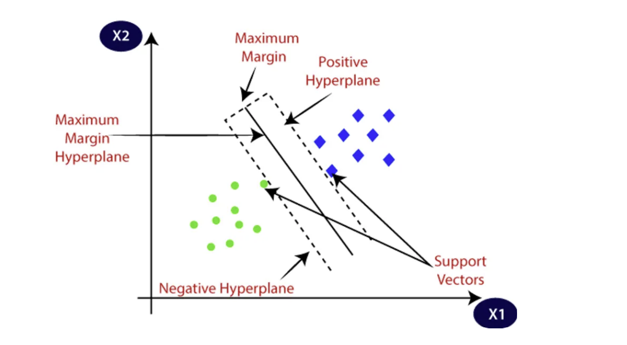
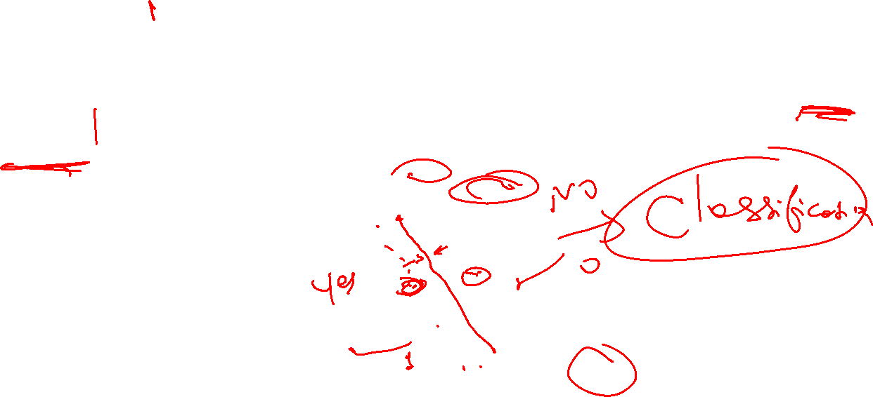
Support Vector Machine

Slide 7
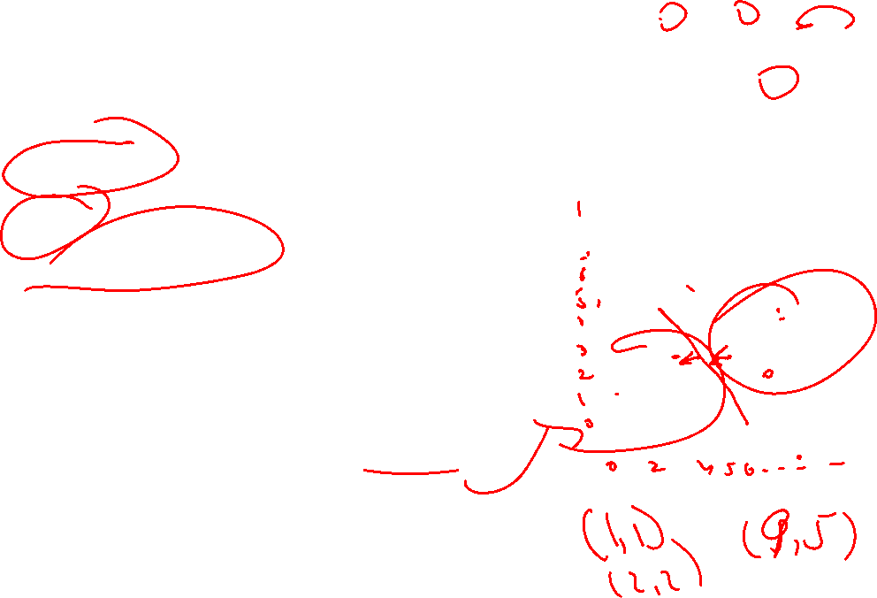
Support Vector Machine
Hyperline
Margin
Support Vectors
Soft Margin
Hard Margin

Slide 8
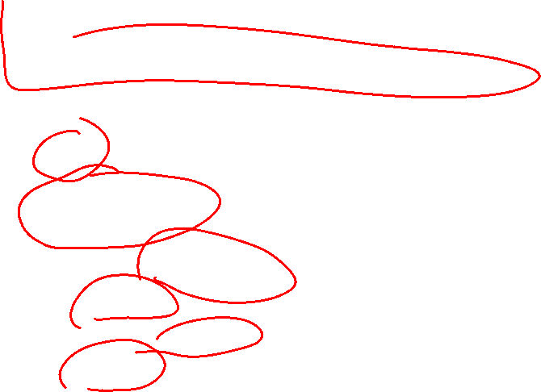
Support Vector Machine
SVM
Classification
Regression
Feature Scaling kerak
Imbalanced datada yaxshi ishlamaydi
Hyperplane orqali datani eng yaxshi(mos) qismlarga ajratish

Slide 9








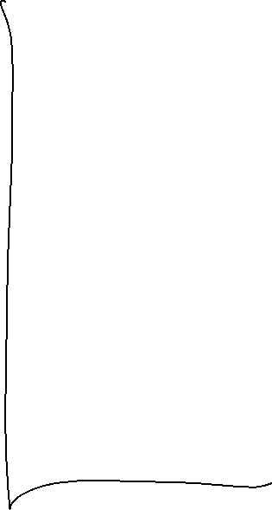


Support Vector Classifier

Slide 10
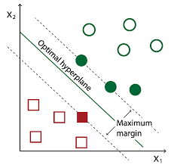
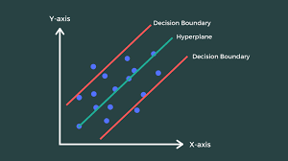
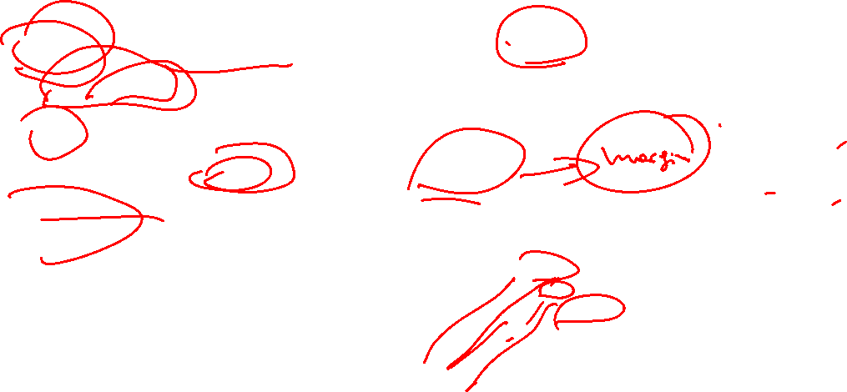
Support Vector Machine
Hyperline--- datalarni qismlarga ajratadigan chegara
Support vectorlar---hyperlinega yaqin bolgan nuqtalar
Margin—hyperline va eng yaqin orasidagi masofa
Asosiy maqsad: 2 ta class orasidagi masofani kengaytirish

Slide 11
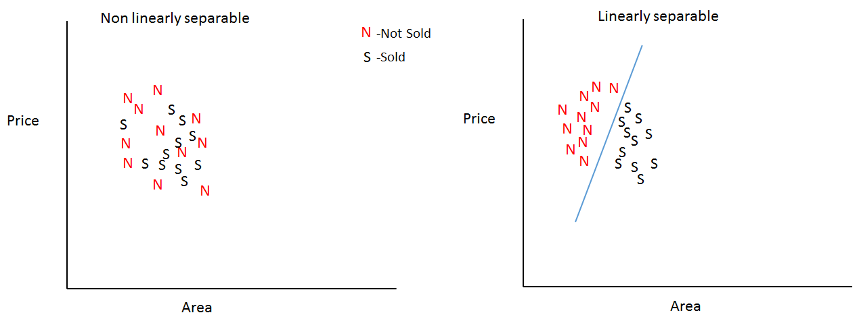

Support Vector Machine
Qachon yaxshi natija chiqaradi : chiziqli ajralganda

Slide 12
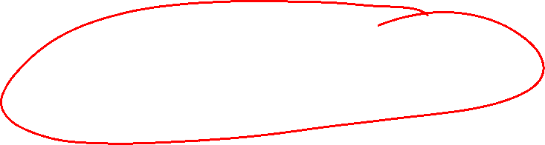
Support Vector Regressor

Slide 13
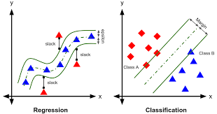
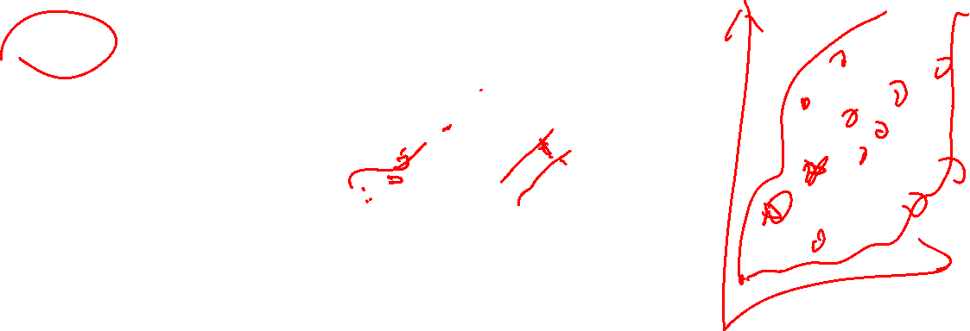
Support Vector Regressor
Margin---- regression line atrofida

Slide 14
Support Vector Regressor
Margin---- regression line atrofida

Slide 15
SVC vs SVR

Slide 16
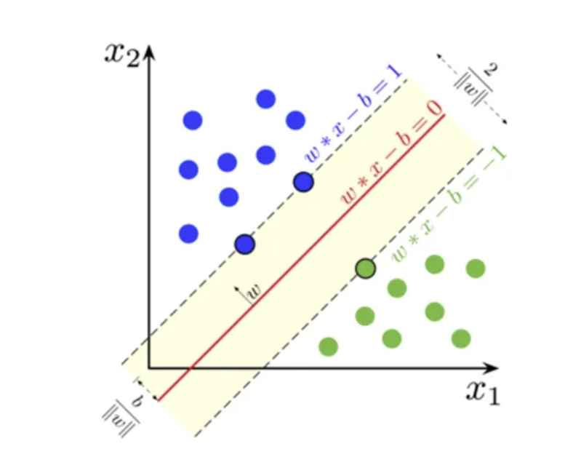
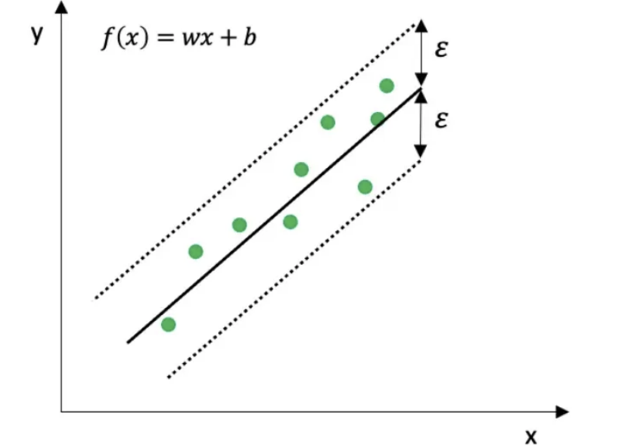
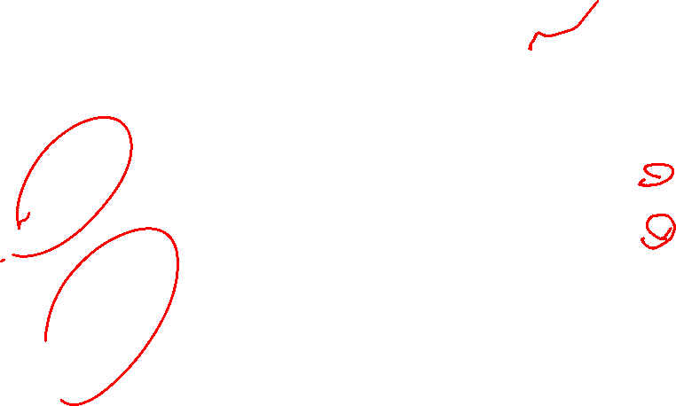
SVC vs SVR
SVC

Slide 17
Support Vector Regressor

Slide 18
Vazifa
Yangi datasetda, tabular orqali qiyoslang:
SVM
Log_reg
Linear_reg
DT
RF

